Slide 1

AN LLM-BASED FRAMEWORK FOR AUTOMATED PYTHON TEST GENERATION AND MUTATION TESTING EVALUATION
Group ID: T2410250
1

Slide 2
Presented by:
Sadnan Nafis
21201249
Abdullah Al Walid
21201651
Amatus Subhan Anuja
24141126
Supervised by:
Md. Aquib Azmain
Lecturer
Department of Computer Science and Engineering
Brac University
Co-supervised by:
Fakhruddin Gazzali
Lecturer
Department of Computer Science and Engineering
Brac University
2
An LLM-Based Framework for Automated Python Test Generation and Mutation Testing Evaluation

Slide 3

Background
INTRODUCTION
In the 1980s, Therac-25 software failures caused serious injuries & deaths. [4]
Software Testing is a vital phase — can consume 30-50% of development effort.
Testing evolved from an unalgorithmic, unstructured task to a systematic, essential process for quality assurance
3
An LLM-Based Framework for Automated Python Test Generation and Mutation Testing Evaluation

Slide 4

Unit Testing is a software testing technique in which individual units or components of a software application are tested in isolation.
Mutation Testing is a type of software testing that is performed to evaluate the quality of existing software tests and also design new software tests.
4
An LLM-Based Framework for Automated Python Test Generation and Mutation Testing Evaluation

Slide 5
PROBLEM STATEMENT
Current Challenges in Software Testing
Issues in Test Case Generation
Research Motivation
Traditional automated methods:
May not meet all requirements
Struggle with complex applications
Weak assertion logic for validating behavior
Full potential not yet achieved due to:
Trade-offs between efficiency, cost, and time
Manual TCG: Time-consuming & error-prone.
Automated TCG: May lack coverage.
Improve Automated Test
case generation using Large Language Models (LLMs)
5
An LLM-Based Framework for Automated Python Test Generation and Mutation Testing Evaluation

Slide 6



Explore different LLMs for test case generation
Compare LLM-generated vs traditional test cases
Generate effective test cases for Mutation Testing using:
Large Language Models (LLMs)
RESEARCH OBJECTIVES
6
An LLM-Based Framework for Automated Python Test Generation and Mutation Testing Evaluation

Slide 7


MuTAP outperforms both Pynguin and traditional LLM-based test generation approaches
Uses LLama and Codex LLMs with zero and few-shot prompting for generating and refining test cases with surviving mutants
Achieved a Mutation Score (MS) of 93.57%
In comparison:
Pynguin scored 65.94% MS
Only 28.22% PUTs had 100% MS with Pynguin
Highlights the efficiency and effectiveness of the MuTAP method
RELATED WORK
7
An LLM-Based Framework for Automated Python Test Generation and Mutation Testing Evaluation

Slide 8
Bhatia et al. compared test cases generated by ChatGPT and Pynguin for coverage results.
Bhatia et al. proposed combining LLMs (e.g., ChatGPT) with traditional tools like Pynguin for better coverage results
Approach uses the minimal overlap between test cases from both sources to enhance test performance
LLMs improve coverage of test cases
However, LLM-generated tests show a higher rate of assertion errors
Assertion errors are less common in traditional methods like Pynguin
RELATED WORK
8
An LLM-Based Framework for Automated Python Test Generation and Mutation Testing Evaluation

Slide 9
ChatUniTest uses adaptive focal context generation after converting Java files to AST (Abstract Syntax Tree)
Utilizes Chain-of-Thought prompting to guide the LLM in test generation
Code Llama is used as the underlying LLM
Achieved 59.6% line coverage, outperforming EvoSuite and TestSpark
RELATED
WORK
9
An LLM-Based Framework for Automated Python Test Generation and Mutation Testing Evaluation

Slide 10

Tools used for generating Test Cases
Traditional Approaches:
Pynguin
Klara
LLM-Based Approaches:
Chatgpt 4.0
Gemini 1.5 Flash
Claude 3.5 Sonnet
Llama 3. 1 70B
10
An LLM-Based Framework for Automated Python Test Generation and Mutation Testing Evaluation

Slide 11
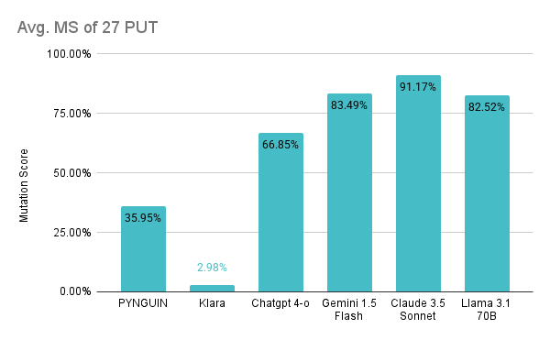

No. of Killed Mutants
MutPy MS
=
(Total - Incompetent - Timed-out)
Average Mutation Score of 27 PUT
11
An LLM-Based Framework for Automated Python Test Generation and Mutation Testing Evaluation

Slide 12
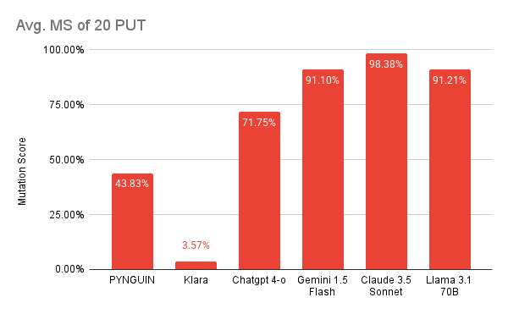
Average Mutation Score of 20 PUT (HumanEval)
12
An LLM-Based Framework for Automated Python Test Generation and Mutation Testing Evaluation

Slide 13
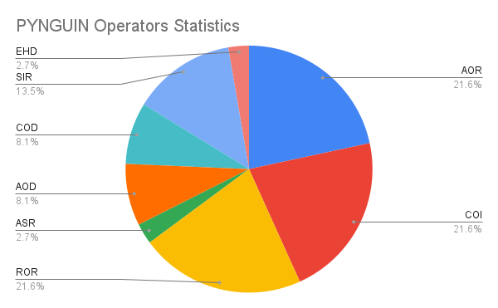
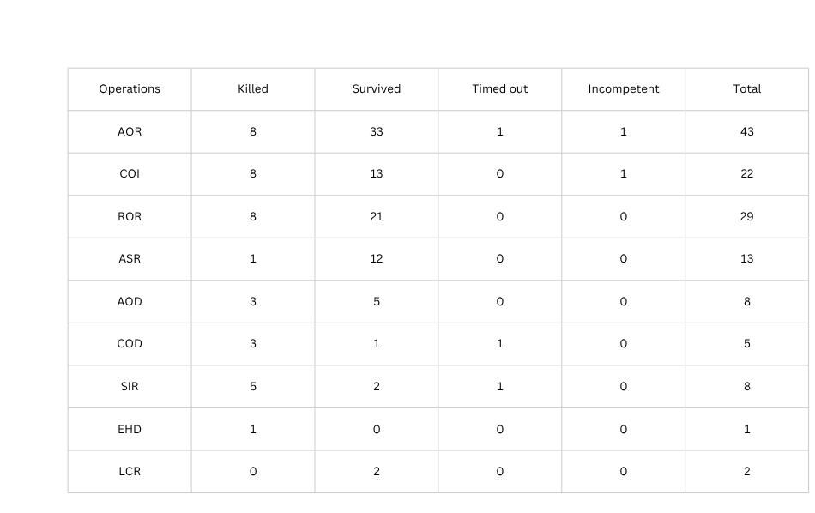
Pynguin
Total generated mutants: 131
Killed: 37
Average mutation score: 43.83%
13
An LLM-Based Framework for Automated Python Test Generation and Mutation Testing Evaluation

Slide 14
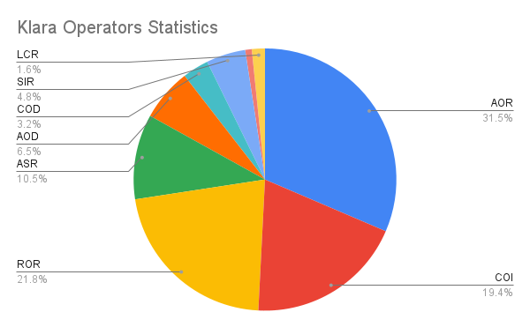


Klara
Total generated mutants: 124
Killed: 1
Average mutation score: 4.03%
14
An LLM-Based Framework for Automated Python Test Generation and Mutation Testing Evaluation

Slide 15
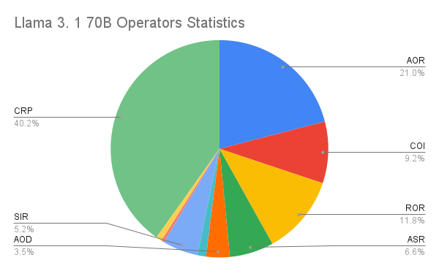


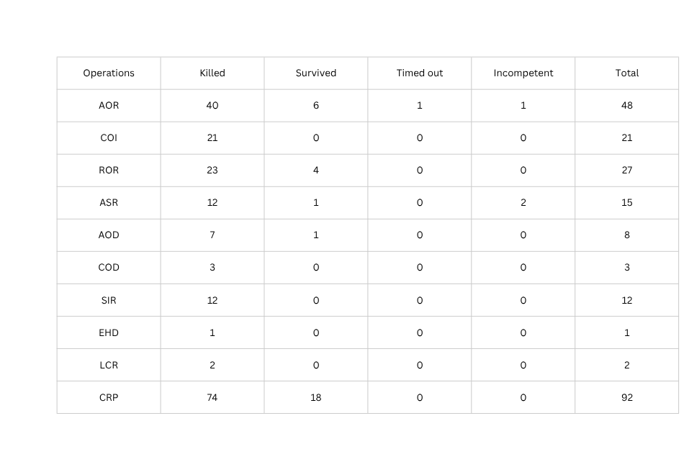
Llama 3.1 70B
Total generated mutants: 229
Killed: 195
Average mutation score: 91.21%
15
An LLM-Based Framework for Automated Python Test Generation and Mutation Testing Evaluation

Slide 16
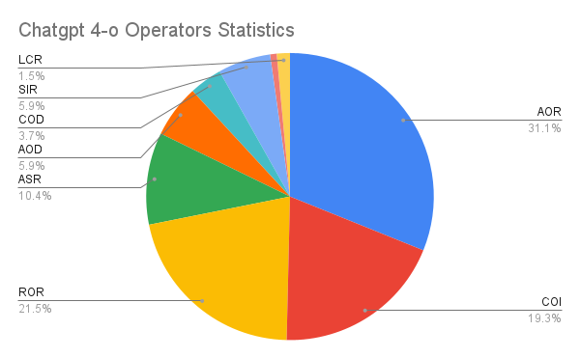

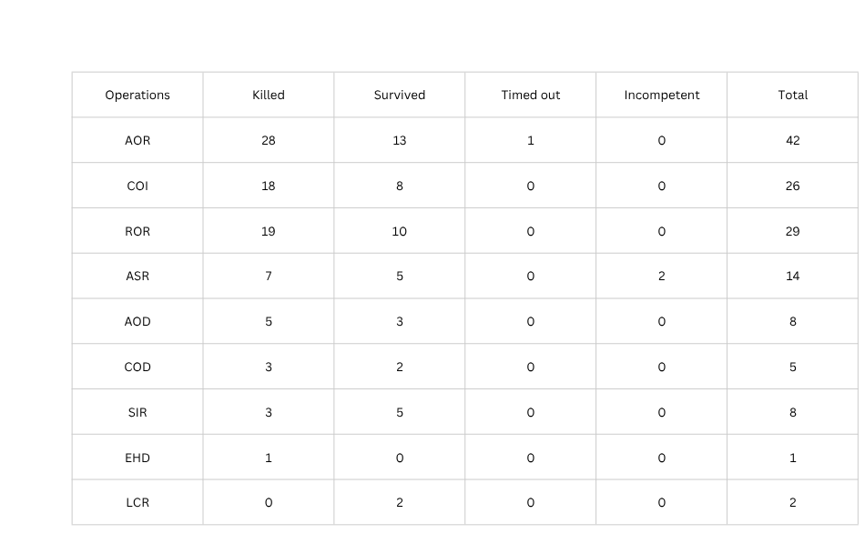


ChatGpt 4-o
Total generated mutants: 135
Killed: 84
Average mutation score: 71.75%
16
An LLM-Based Framework for Automated Python Test Generation and Mutation Testing Evaluation

Slide 17
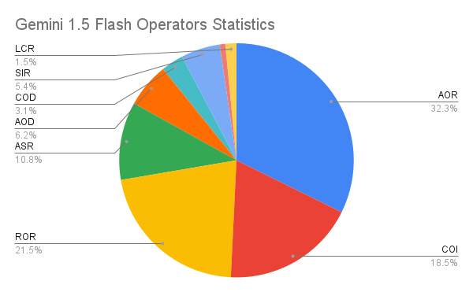
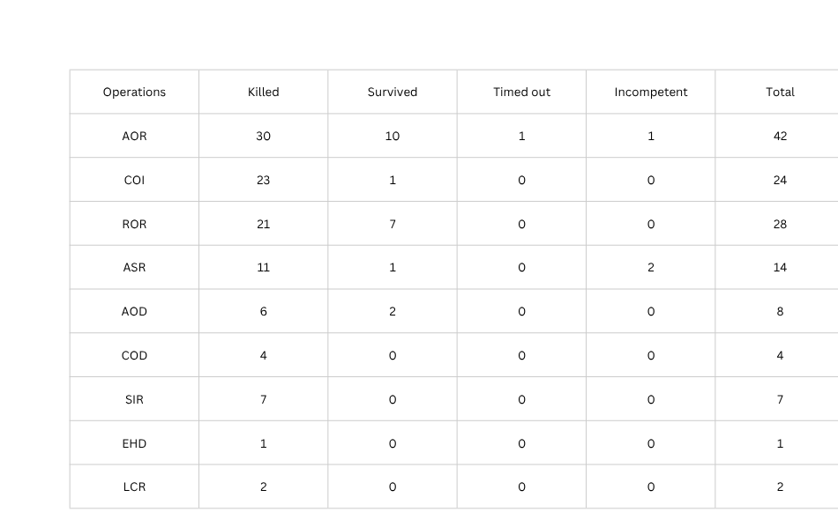
Gemini 1.5 Flash
Total generated mutants: 130
Killed: 105
Average mutation score: 91.10%
17
An LLM-Based Framework for Automated Python Test Generation and Mutation Testing Evaluation

Slide 18
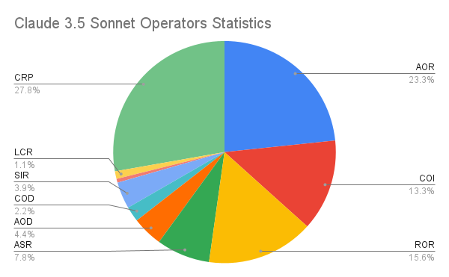






Claude 3.5 Sonnet
Total generated mutants: 180
Killed: 171
Average mutation score: 98.00%
18
An LLM-Based Framework for Automated Python Test Generation and Mutation Testing Evaluation

Slide 19
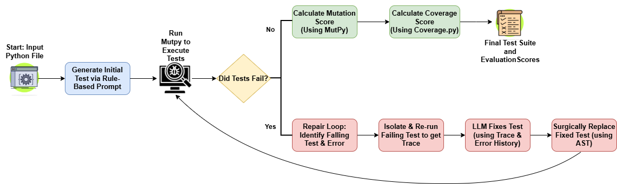
Methodology
Fig: Workflow of ASTRA
ASTRA (Automated Software Testing, Repair, and Analysis)
19
An LLM-Based Framework for Automated Python Test Generation and Mutation Testing Evaluation

Slide 20

Prompt Engineering
Phase 1: Zero-Shot Prompting
Minimal instruction: “Generate test cases from code”
Problems:
Hallucinated fixes
Weak or failing test cases
Lacked structure and consistency
20
An LLM-Based Framework for Automated Python Test Generation and Mutation Testing Evaluation

Slide 21
Prompt Engineering
Phase 2: Rule-Based Prompting
Introduced strict, task-specific rules:
Source code is the only truth
No assumptions about expected output
Assertions must match actual behaviour
Result: Better correctness, structure, and coherence
21
An LLM-Based Framework for Automated Python Test Generation and Mutation Testing Evaluation

Slide 22
Prompt Engineering
Phase 3: Chain-of-Thought (CoT) Prompting
Chain-of-Thought (CoT) for stepwise reasoning:
Identify failing test
Analyse actual vs expected
Apply fix
Contextual Injection:
Includes source, traceback, execution trace, past failures
In-Context Learning from Failure:
Avoids repeated fixes
Uses randomness parameter tuning to explore alternatives
22
An LLM-Based Framework for Automated Python Test Generation and Mutation Testing Evaluation

Slide 23
Results
Data Selection
Used 70 Python functions from the HumanEval dataset
Avoided files with native extensions or complex dependencies
Selected 18 Python projects [3] for additional evaluation
Function-based
23
An LLM-Based Framework for Automated Python Test Generation and Mutation Testing Evaluation

Slide 24
Results
70 HumanEval Python functions
Metric | Average Value (%)
Mutation Score | 96.01
Coverage | 98.64
Our tool achieves a higher Average MS compared to MuTap’s 93.57%. [1]
24
An LLM-Based Framework for Automated Python Test Generation and Mutation Testing Evaluation

Slide 25
Results
18 Python project files
Metric | Average Value (%)
Mutation Score | 92.43
Coverage | 96.33
Our tool achieves a higher average coverage compared to ChatGPT’s 92.47% and Pynguin’s 90.20% [3].
25
An LLM-Based Framework for Automated Python Test Generation and Mutation Testing Evaluation

Slide 26
Limitations
Challenges related to data privacy
Long-term reproducibility of results
Prompt engineering for specific LLM models
Scalability issues for large codes
26
An LLM-Based Framework for Automated Python Test Generation and Mutation Testing Evaluation

Slide 27
Future Work
Enhance the system’s accessibility and modularity by integrating support for other LLMs or even open-source LLMs that can be run locally.
Refactor the architecture to be language-agnostic.
27
An LLM-Based Framework for Automated Python Test Generation and Mutation Testing Evaluation

Slide 28

Conclusion
Full Automation
Self-Healing Framework
Smarter Quality Assurance
End-to-end unit test generation and repair with zero manual effort
Uses execution traces and LLM reasoning to fix broken tests autonomously
Combines coverage with mutation-based fault detection for robust testing
28
An LLM-Based Framework for Automated Python Test Generation and Mutation Testing Evaluation

Slide 29
References
[1] A. M. Dakhel, A. Nikanjam, V. Majdinasab, F. Khomh, and M. C. Desmarais, “Effective test generation using pre-trained large language models and mutation testing,” Information and Software Technology, vol. 171, p. 107 468, 2024, issn: 0950-5849. doi: https://doi.org/10.1016/j.infsof.2024.107468. [Online]. Available: https : / / www . sciencedirect . com / science / article / pii /S0950584924000739.
[2] Y. Chen, Z. Hu, C. Zhi, J. Han, S. Deng, and J. Yin, Chatunitest: A framework for llm-based test generation, 2024. arXiv: 2305.04764 [cs.SE]. [Online]. Available: https://arxiv.org/abs/2305.04764.
[3] S. Bhatia, T. Gandhi, D. Kumar, and P. Jalote, Unit test generation using generative ai : A comparative performance analysis of autogeneration tools, 2024. arXiv: 2312.10622 [cs.SE]. [Online]. Available: https://arxiv.org/abs/2312.10622.
[4] N. Leveson and C. Turner, “An investigation of the therac-25 accidents,” Computer, vol. 26, no. 7, pp. 18–41, 1993. doi: 10.1109/MC.1993.274940.
29
An LLM-Based Framework for Automated Python Test Generation and Mutation Testing Evaluation

Slide 30
Thank You
30

Slide 31
Backup Slides
31

Slide 32
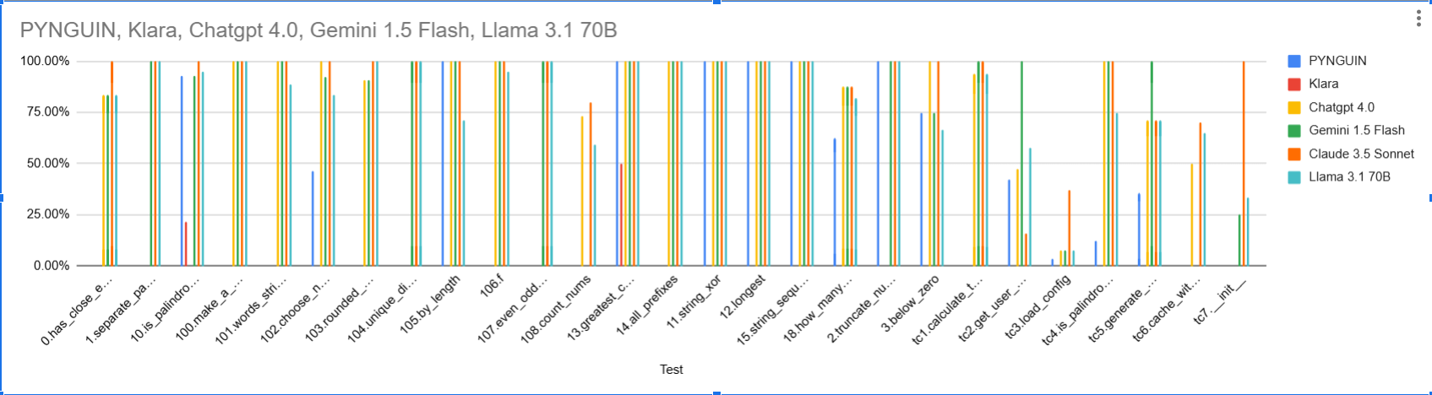
Mutation Score
MutPy was used to calculate the mutation Score for different
MutPy mutation score = No. of killed mutants/(total - incompetent - timed-out) mutants.
32
An LLM-Based Framework for Automated Python Test Generation and Mutation Testing Evaluation

Slide 33
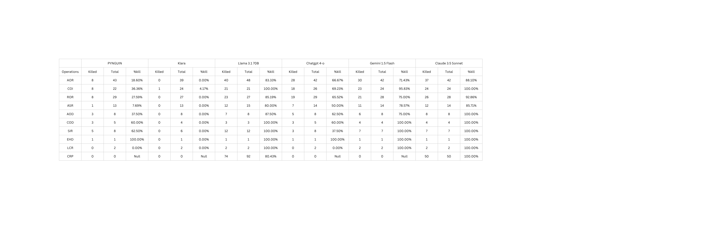
Operator-wise performance of different LLMs and Traditional softwares
33
An LLM-Based Framework for Automated Python Test Generation and Mutation Testing Evaluation

Slide 34
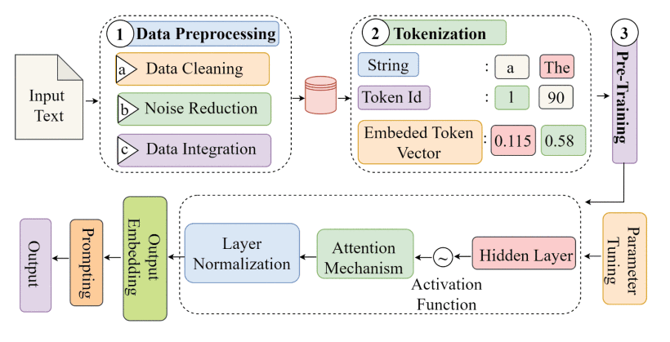
LLM Pipeline
34

Slide 35
AOR
Arithmetic Operator Replacement
Replaces arithmetic operators (e.g., + → -, * → /)
COI
Conditional Operator Insertion
Adds extra conditions to expressions (e.g., inserting && true)
ROR
Relational Operator Replacement
Changes relational operators (e.g., > → <, == → !=)
ASR
Assignment Operator Replacement
Replaces assignment operators (e.g., += → -=)
AOD
Arithmetic Operator Deletion
Deletes arithmetic operations (e.g., a + b → a)
COD
Conditional Operator Deletion
Removes conditionals (e.g., removing if (x > 5))
SIR
Statement Insertion Replacement
Inserts or replaces statements (less common, tool-specific)
EHD
Exception Handling Deletion
Removes exception handling blocks (e.g., try-catch)
LCR
Logical Connector Replacement
Replaces logical operators (e.g., && → `)
CRP
Constant Replacement
Replaces constants with other values (e.g., 5 → 0)
35

Slide 36

LLM Inference Cost Estimation (Gemini 2.0 Flash Paid Tier)
Model Pricing:
Input: $0.35 per 1M tokens
Output: $1.50 per 1M tokens
1. Test Generation Call
Input size: ~2,000 tokens
Output size: ~2,500 tokens
Cost Breakdown:
Input: (2,000 ÷ 1,000) × $0.00035 = $0.0007
Output: (2,500 ÷ 1,000) × $0.0015 = $0.00375
Total Generation Cost: ~$0.0045
(less than half a cent)
2. Test Repair Call
Input size: ~10,000 tokens
Output size: ~100 tokens
Cost Breakdown:
Input: (10,000 ÷ 1,000) × $0.00035 = $0.0035
Output: (100 ÷ 1,000) × $0.0015 = $0.00015
Total Repair Cost (per attempt): ~$0.0037
36

